Slide 1
House-Rent Prediction SYsTem
Presented by:
Md. Iftakarul Islam Suvo
ID: 1511088042

Slide 2
What was the problem?
The problem was about predicting a customer the approximate rent of a certain house or flat in a certain area.
The customer can say which flat or house will be suitable for him based on the prediction it gives.
Then the customer can choose which house/flat will be suitable for him to shift and to live there in rent.

Slide 3
Which algorithms are used?
Linear Regression
Decision Tree
Lasso Regression

Slide 4
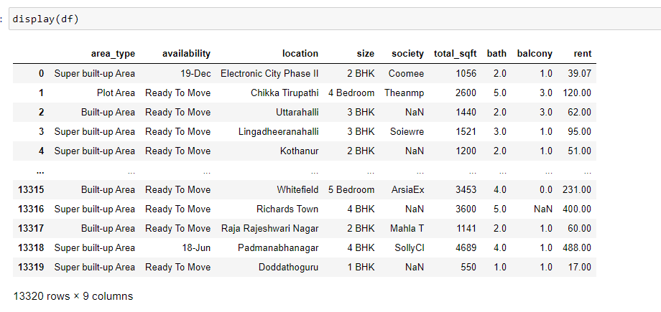
Data Set
I have used the data of Bengaluru city in this project. I have got the dataset from Kaggle.

Slide 5
Result & Discussion
Here the table shows variance of the dataset in each algorithm used.
Algorithm | Variance
Linear Regression | 1.00
Decision Tree | 1.00
Lasso Regression | 1.00

